Slide 1
INTENSIO’S MEMORABLE MEMORY GAME

Slide 2
Team Members
William Holder
Timothy Sullivan
Jason Purcell
Patrick Poirson
Hao Wu

Slide 3
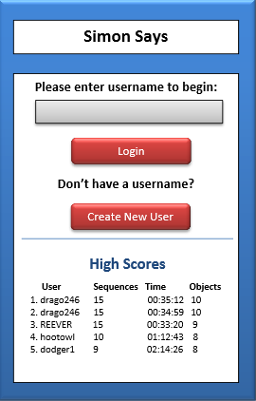
Overview
Tests memory
Persistent high scores
Java web application
Android application

Slide 4
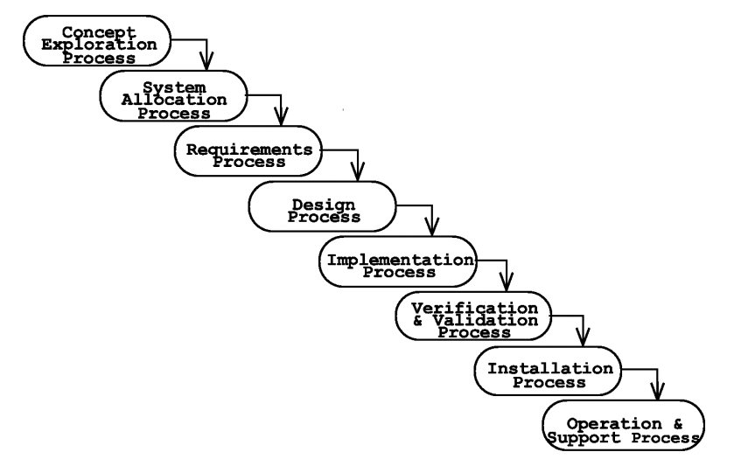
Lifecycle Methodology
Waterfall method

Slide 5
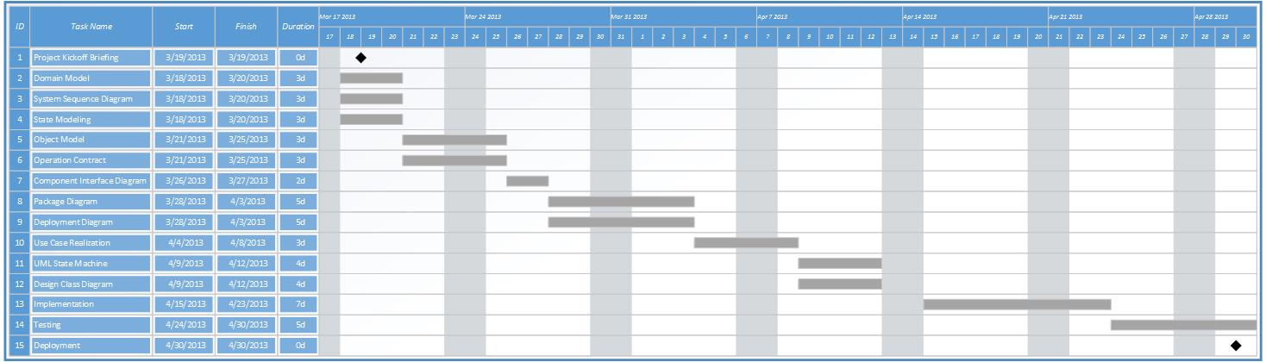
GANT Chart

Slide 6
Risk Analysis
Low Moderate High Severe
Mitigation strategy

Slide 7
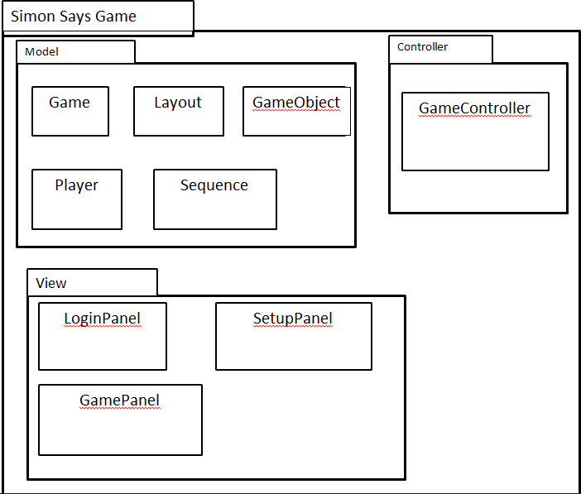
Initial Software Architecture
Model
Player
Game and components
View
Login
Setup
Game
Controller

Slide 8


Documentation and Configuration Management Plan Summary

Slide 9

Technical Environment Summary
IDE:
Eclipse
Programming Language:
Java
Platforms:
Java SDK
Android SDK
Source Code Control:
Git-hub
Team Communication:
Big Blue Button
Skype

